Slide 1
Using RDMA Efficiently for Key-Value Services
Anuj Kalia (CMU), Michael Kaminsky (Intel Labs), David Andersen (CMU)

Slide 2
Contribution
Analyze the performance of RDMA verbs
Design and implement HERD
a key-value cache, which offers the maximum possible performance of RDMA hardware.

Slide 3
Background
RDMA
A network feature that allows direct access to the memory of a remote computer.
In-memory KV stores
Interface: GET, PUT
Requirements:
Low latency
High request rate

Slide 4
RDMA Verbs and Transport types
RDMA Verbs
READ and WRITE
SEND and RECV
Transport types
RC
UC
UD
Notes:
Transport types:
R & U : ack/nak or not
C & D : each has a queue in sender

Slide 5
Notes:
几种Verb和Transport的对比

Slide 6
RDMA WRITEs faster than READs
Reason: PCIe writes faster than PCIe reads

Slide 7
Notes:
For small payloads, WRITE with inlining has a higher outbound throughput than READ.

Slide 8
Design Decision
Using RDMA WRITE instead of RDMA READ
Using UD for responses
Notes:
两大设计方向

Slide 9
Approach
Reduce round trip
Request-reply with server CPU involvement
Increase throughput
Low level verbs optimizations
Improve scalability
Use datagram transport

Slide 10
Reduce round trip
Recent systems
Use RDMA reads to access remote data structures
the allure of CPU bypass
At least 2 RDMA reads required:
≧ 1 to fetch address
1 to fetch value

Slide 11
Reduce round trip
HEAD
Use a single round trip, with only 2 RDMA writes
Server CPU involves client’s request

Slide 12
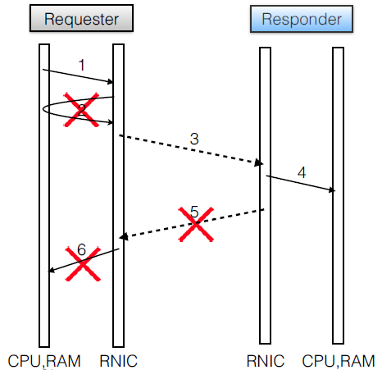
Increase throughput
Inlining
encapsulate payload in request descriptor (2→1)
Unreliable
use unreliable transport (- 5)
Unsignaled
don’t ask for request completions (- 6)

Slide 13
Increase throughput

Slide 14
Improve scalability
Outbound WRITEs scale poorly
RNICS must manage queue pairs for all connected transports
But there are usually lots of client machines
Inbound WRITEs scale well
Inbound state is much little than outbound state

Slide 15
Improve scalability
Use datagram for outbound replies
Datagram only supports SEND/RECV
SEND/RECV is slow only at the receiver

Slide 16
Improve scalability

Slide 17
Evaluation
HERD = Request-Reply + MICA [NSDI 2014]
Compare against emulated versions of Pilaf and FaRM-KV
No datastore
Focus on maximum performance achievable
Two types of workloads
read-intensive (95% GET, 5% PUT)
write-intensive (50% GET, 50% PUT)
Notes:
Pilaf
GET：平均1.6bucket READs找到指针，然后发一个Sv byte的READ取得值
PUT：SEND一个Sk+Sv byte的message（包含key和value）
FaRM
GET：FaRM-em：一次6*(Sk+Sv) byte的READ；FaRM-em-VAR：a 6 * (SK +SP) byte READ followed by a SV byte READ
PUT：Sk+Sv byte WRITE from client to server， and one WRITE for completion message from server to
client

Slide 18
End-to-end throughput comparison with different value sizes
Notes:
16 byte keys，read-intensive workload
FaRM-em：inlined value
FaRM-em-VAR：for variable length values
Pilaf-em-OPT：enable all of our RDMA optimizations for both request types

Slide 19
End-to-end latency with 48 byte items and read-intensive workload
Notes:
read-intensive workload
adding more clients until the server is saturated
FaRM-em provides the lowest latency among the three systems because it requires only one network round trip (unlike Pilaf-em-OPT) and no computation at the server (unlike HERD).

Slide 20
Throughput with variable number of client processes and different window sizes
Notes:
the decline is due to cache misses in RNICS,

Slide 21


